Slide 1
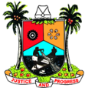


LAGOS STATE GOVERNMENT
Budget Performance Appraisal
1ST QUARTER, 2023
Government Secretariat,
Alausa, Ikeja,
Lagos State, Nigeria.
web: http://lagosstate.gov.ng
email: info@lagosstate.gov.ng
twitter: @followlasg

Slide 2
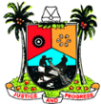

Contents
MEMO FROM THE COMMISSIONER
3-4 VISION & MISSION
5 MEMO FROM THE COMMISSIONER
6 PURPOSE OF THE REPORT
7-15 ECONOMIC PROFILE
16-20 BUDGET PERFORMANCE SUMMARY
21-23 BUDGET PERFORMANCE HIGHLIGHTS
24-26 CAPITAL/RECURRENT EXPENDITURE PERFORMANCE HIGHLIGHTS
27-50 BUDGET OBJECTIVES APPRAISAL
51-54 THINGS TO NOTE
55 CONCLUSION

Slide 3
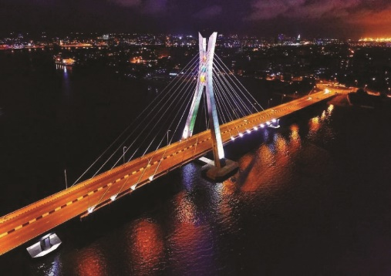
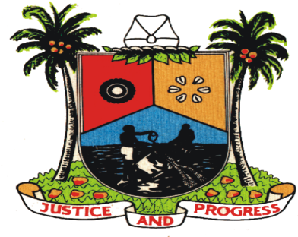
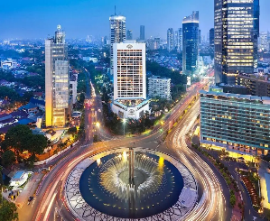
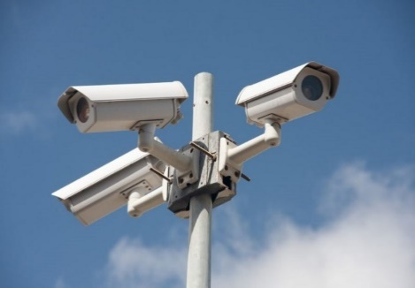
MEMO FROM THE COMMISSIONER
Africa’s Model Megacity
Lagos is Africa’s Largest city with a population of over 28 million people with a growth rate of 2.55%. The City remains a pacesetter for other African cities owing to its rapid economic growth, urbanization, and its cultural diversity
THE VISION
A Global Economic and Financial Hub
Lagos is one of Africa's fastest-growing economies, with a GDP of over $76 billion in 2021. The city maintains its position as one of the best African cities for startups, is home to one of Africa's busiest seaports, and serves as the country office for tech giants such as Google and Microsoft.
Safe, Secure, Functional and Productive
Lagos is a top destination for capital importation in Africa. In Q2 2022, Lagos attracted capital investment worth $1,054.18 million accounting for 68.66% of total capital investment into Nigeria
The State allocated N86 billion to its Public Order and Safety Sector, demonstrating the State's ongoing commitment to ensuring safety and a high quality of life.

Slide 4
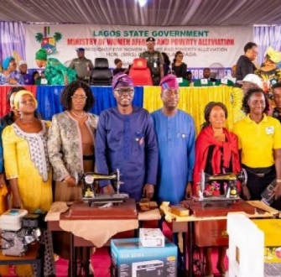
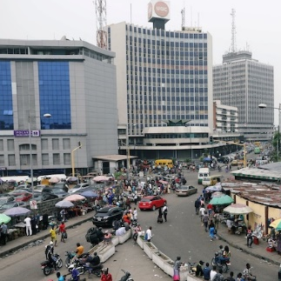
Poverty Eradication
Lagos State has about 3 million poor and vulnerable individuals and households on its single social register, and the state has lifted 406,767 people out of poverty through various initiatives over the last three years
THE MISSION
Sustainable economic growth
Lagos prioritizes long-term economic development that is balanced with social and environmental sustainability thus creating a more resilient and prosperous community that benefits everyone
Infrastructure renewal and development
Lagos has allocated 24% of the Y2023 budget to its Economic Affairs sector which caters for infrastructural renewal and development, as part of its efforts to modernize the city and support its growing population
The State has launched several initiatives and projects to improve infrastructure in road construction, housing, public transportation, and power supply

Slide 5
MEMO FROM THE COMMISSIONER
WELCOME
This Budget Performance Report for Q1 Y2023 provides information on activities and performance of the Budget which we trust all stakeholders will find useful. The report provides financial information and offers some insights into the contexts and experiences that have aided the achievement of goals or presented challenges to realizing desired outcomes.
Importantly, the Ministry of Economic Planning and Budget (MEPB) has been working hard to lay the foundations necessary to ensure improvements in our approach and activities. This will ensure optimal performance of the Ministry’s oversight function, and the implementation of sound recommendations informed by a variety of factors including lessons learnt from our engagements and the broader external context.
The Ministry is committed to providing information to all our stakeholders in a manner that empowers decision makers, increases confidence and promotes active engagement of readers and the larger community.
MR. SAM EGUBE
Honourable Commissioner
Ministry of Economic Planning & Budget

Slide 6
PURPOSE OF THE REPORT
DEC
NOV
JAN
1
FIRST Quarter Year 2023 Budget Performance
OCT
FEB
2
Identify Budget Implementation Challenges
SEP
Y2023 Budget Performance Review
MAR
3
Apply Lessons Learnt in Year 2022 in driving subsequent Budget Implementation
AUG
APR
4
Proffer Suggestions and Solutions for Improvement
JUL
MAY
JUN

Slide 7
Q1 Y2023
Economic Profile

Slide 8
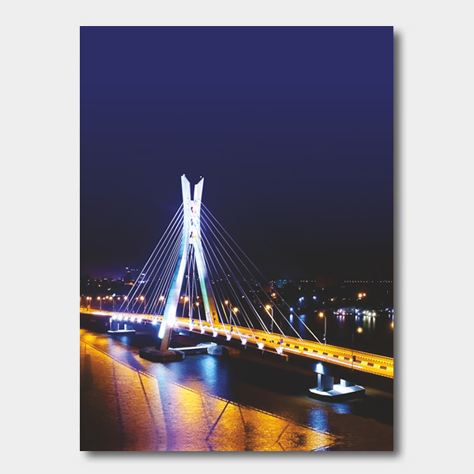
Lagos State GDP is expected to nosedive significantly in Q1 Y2023 following multiple unfavourable monetary and fiscal policies and an existential impact of global economic pressures
GDP
KEY FINDINGS
The CBN's hawkish stance by raising MPR to 18% is likely to continue if inflation remains high until the impact on GDP in Q1 Y2023 can be assessed. However, this increase will continue to have a negative impact on local production.
Inflation
The recent CBN New Naira policy, which caused a cash crunch, has harmed not only demand but also goods and services. Since approximately 40% of the N30tn Lagos economy is informal, 90% of which is cash-based, and 30% of the formal sector is also cash-based, hence an estimated N16.2tn of Lagos State's annual GDP is cash-based.
Cash Policy
Economic activities such as agriculture, manufacturing activities (especially food & beverage, textiles, and apparel), trade, arts entertainment & recreation, accommodation & food services, road and water transport and other services are expected to be the most affected.
Economy
The Ease of Doing Business rating has little impact on Internally Generated Revenue and thus little impact on State Revenue. However, in order to improve its ranking on EoDB, Lagos should pay close attention to its Commerce and Industry regulations and policies.
EoDB

Slide 9





22.64%
External Reserves declined to
The State inflation declined to 22.67% in February 2023 from 24.71% in January 2023. The volatility of inflation in Nigeria particularly in Lagos State is complex due to government policies, fluctuations in the exchange rate, and changes in global commodity prices.
$35.53B
External Reserves declined by about 4% to $35.53billion at the end of March 30th,2023, from its January figures of $36.99billion. The decline is attributed to the fall in global crude oil prices as the country is heavily reliant on crude oil export for its foreign exchange earnings
Lagos State was ranked 29th on the 2023 Subnational Ease of Doing Business (EoDB)
ECONOMIC HIGHLIGHTS
According to a report released by the Presidential Business Environment Council (PEBEC), Lagos fell from 20th in 2021 to 29th in 2023 on the EoDB report. According to the report, reforms must be properly communicated and designed to address the specific pain points of MSME.
Investment partnership between Lagos State and e-Tranzact for integrated technology solution.
The State signed a Memorandum of Understanding (MoU) with eTranzact to deploy an integrated technology solution for data collection, management, and digitization of revenue collection processes to regulate them and enhance the state’s Internally Generated Revenue
The blue line train will create a life-changing urban rail project that will transform mobility in the state, running from Marina Station to Mile 2 station.

Slide 10




The Naira Re-Design Policy
On October 26, 2022, the Central Bank of Nigeria (CBN) announced plans to redesign the 200, 500, and 1,000 denominations of the local currency in order to mop up money in circulation and track money laundering activities. This policy suffered more setbacks than the apex bank had anticipated, as its implementation proved to be both ill-timed and counterproductive.
Thus, we identify four (4) negative effects of the policy as enumerated below:
Effects
Assessment
The Naira redesign policy caused a severe cash crunch in the country, making transactions difficult for both businesses and individuals, effectively ending a 31-month growth in business activities and crippling struggling businesses.
A severe cash crunch
Emergence of the Naira Black Market
The poor implementation of the Naira redesign policy resulted in Naira scarcity, which led an unofficial market for the local currency where Nigerians pay as high as 30% per withdrawal amount
Many Nigerians viewed the policy as a political move rather than a necessary monetary policy. As a result, people lose confidence in the government's ability to implement the policy and manage the economy.
Public Perception
As a result of the redesign policy, long lines formed in banks as people attempted to exchange old notes for new ones. This caused significant inconvenience for the general public, particularly those who were unable to access their own funds for extended periods of time, resulting in the loss of lives and destruction of property in some states.
Inconvenience to the Public

Slide 11
Hawkish CBN Policy
The Central Bank of Nigeria’s persistent increase of the Monetary Policy Rate (MPR) to 18% within a 10-month period which increased the MPR by 650 basis points, as a means to control inflation and stabilize the value of the currency has refused to abate the upward inflationary trend and Naira value depreciation.
The high MPR within a short period has succeeded in creating a ripple effect across the whole economy, sinking consumer confidence, leading to fewer jobs and lower wages, fall in stock prices, and may eventually tip the economy into a recession.
Effects
Assessment
This policy exerts a negative impact on the business environment as existing businesses find it difficult to expand while discouraging startups due to the increase in interest on loans and other credit by the Commercial banks. Hence, reducing economic activities.
Cost of Borrowing
While we anticipate prices of goods to fall due to lower spending as a result of the Central Bank of Nigeria MPR Policy, businesses are constrained by the cost of production due to high transportation costs, high-interest rates, high exchange rates, and expensive energy. As a result, businesses fail, and the ones that survive raise product prices, keeping inflation on the rise.
Reduced Spending
Continuously raising interest rates in an economy with existing severe socio-economic challenges will further compound these challenges and stomp any immediate chance for recovery. The twin effect of a cash crunch and increasing interest rate will be catastrophic and will be evident long after the policy is overturned.
A recipe for recession

Slide 12
Lagos State Debt Service and Revenue- A measure of liquidity
The debt service to revenue ratio looks at the ability of the State's revenue to cover its debt service obligations.
The debt service to Gross State Income (GSI) ratio in Y2022 is 26.86%, a rise of 2.85% from Y2021, indicating a good balance between debt and revenue.
While this may encourage additional borrowing, policymakers must consider the current realities of borrowing costs as global interest rates rise.
Our Analysis suggested that the government focus on increasing transparency in debt contracts in order to encourage debt restructuring and build trust among current and future creditor groups.
12
Source: Financial Statement (2017-2021), Lagos DMO

Slide 13

Lagos State Debt by Numbers
USD1.25B
N807.2B
15.1%
Total External Debt Stock as at December 2022
Total Domestic Debt Stock as at December 2022
Share of the total domestic debt owed by the 36 states and FCT
2.16%
69%
N1.367T
Marginal Increase on a quarter-on-quarter basis from Q1 to Q2 2022 (Domestic Debt)
Percentage of Domestic Debt to External Debt as at December 2022
Total Debt Stock as at December 2022
4.5%
71.2%
63.4%
Total Debt Stock to GDP as at December 2022
Total Revenue to Total Debt Stock as at December 2022
Total IGR to Domestic Debt as at December 2022

Slide 14

Lagos State was ranked 29th on the 2023 Subnational Ease of Doing Business (EoDB)
The recent Presidential Business Environment Council (PEBEC) report on EoDB downgraded Lagos State’s rating from 20th in 2021 to 29th in 2023.
Lagos EoDB ranked lowest on the average; "Number of days taken to resolve security incidents" at 3.53days, National average at 9.23days, and 43.36days in Niger State. The state seems to perform poorly across other measured indicators.
According to the report, simply implementing reforms is insufficient to improve EoDB satisfaction; reforms must also be properly communicated and designed to address the specific pain points of MSME.
It is important to note that a city or country can have a high internal revenue from taxes, charges, and fees while ranking low on ease of doing business. Moscow, Mumbai, and Rio de Janeiro are among the world's wealthiest cities, generating significant revenue through taxes but ranking low in terms of ease of doing business.
The report identified poor infrastructure, bureaucratic processes, corruption, inefficient judicial system, and lack of skilled labor as the major challenges of EoDB

Slide 15
Lagos State was ranked 29th on the 2023 Subnational Ease of Doing Business (EoDB)
The report addresses the ease of doing business across 6 indicators and 16 sub-indicators
INFRASTRUCTURE
Electricity: Availability, cost and experience
Transportation: Availability and quality
Logistics: Availability, cost and quality
Telecom and internet: Cost and quality
TRANSPARENCY AND ACCESSIBILITY OF INFORMATION
Investment Promotion: Availability and experience
Accessing key information: Availability and awareness
ECONOMIC OPPORTUNITY
Funding: Availability, cost and experience
Forex: Availability and experience
New/range of customers: Accessibility
The Survey was conducted to gain understanding on the strengths and weaknesses of each subnational
REGULATORY ENVIRONMENT
Business registration: Availability, cost and experience
License renewal: Availability, cost and experience
Contract enforcement: Availability and accessibility
Land and property acquisition: Availability, cost and experience
Paying taxes: Availability, cost and experience
Sub-nationals Represented
36 + 1
Total Respondents
2852
60%
Small & Micro Enterprises
35% Mid Size Companies
5% Large Companies
SKILLS AND LABOUR
Skills and labour: Availability
Agriculture, Transportation, Construction,
Trade, IT &Comms, Manufacturing,
Health, Entertainment, Tourism,
Professional Services
Industries Represented
10
SECURE AND STABLE ENVIRONMENT
Security and Safety: Availability and experience
Duration
17 Weeks

Slide 16
Q1 Y2023
Budget Performance Summary

Slide 17
Budget Performance Summary (Revenue)
2023 Approved Budget
(₦’Mn)
1ST QUARTER Y2023
Perf.
(%)
FISCAL ITEMS
Budget
Jan. – Mar. (₦’Mn)
Actual
Jan. – Mar. (₦’Mn)
TOTAL REVENUE | 1,417,604 | 354,401 | 269,609 | 76
REVENUE AND GRANTS | 1,417,604 | 354,401 | 269,609 | 76
Federal Transfers | 274,235 | 68,559 | 67,192 | 98
Statutory Allocation | 60,000 | 15,000 | 12,391 | 83
13% Derivations | 3,900 | 975 | - | -
Other FAAC Transfer | 10,335 | 2,584 | 6,043 | 234
Value Added Tax | 200,000 | 50,000 | 48,758 | 98
TOTAL INTERNALLY GENERATED REVENUE | 1,143,369 | 285,842 | 202,417 | 71
INTERNALLY GENERATED REVENUE | 1,045,851 | 261,463 | 179,912 | 69
Lagos Internal Revenue Services | 682,906 | 170,726 | 148,765 | 87
Internally Generated Revenue(Others) | 241,899 | 60,475 | 21,650 | 36
Dedicated Revenue | 89,411 | 22,353 | 9,457 | 42
Investment Income | 6,645 | 1,661 | 40 | 2
Opening Balance | 24,991 | 6,248 | - | -
CAPITAL RECEIPTS | 97,518 | 24,380 | 22,505 | 92
Grants | 51,882 | 12,970 | 1,631 | 13
Other Capital Receipts | 45,636 | 11,409 | 20,874 | 183

Slide 18
Budget Performance Summary (Recurrent - Debt & Non-Debt)
2023 Approved Budget
(₦’Mn)
1ST QUARTER Y2023
Perf.
(%)
FISCAL ITEMS
Budget
Jan. – Mar. (₦’Mn)
Actual
Jan. – Mar. (₦’Mn)
RECURRENT EXPENDITURE (DEBT & NON DEBT) | 748,097 | 187,024 | 113,227 | 61
RECURRENT DEBT | 88,827 | 22,207 | 17,668 | 80
Debt Charges (External) | 8,055 | 2,014 | 2,689 | 134
Debt Charges (Internal) | 78,772 | 19,693 | 14,978 | 76
Bond Charges | 2,000 | 500 | - | -
RECURRENT NON DEBT
Total Personnel Costs | 227,581 | 56,895 | 46,239 | 81
Total Overhead Costs | 431,688 | 107,922 | 49,320 | 46
Overhead Costs | 230,882 | 57,720 | 31,595 | 55
Dedicated Expenditure | 89,411 | 22,353 | 9,457 | 42
Subvention | 111,396 | 27,849 | 8,268 | 30

Slide 19
Budget Performance Summary (Capex and Financing)
2023 Approved Budget
(₦’Mn)
1ST QUARTER Y2023
Perf.
(%)
FISCAL ITEMS
Budget
Jan. – Mar. (₦’Mn)
Actual
Jan. – Mar. (₦’Mn)
SURPLUS/(DEFICIT) ON CRF | 669,507 | 167,377 | 156,382 | 93
TOTAL CAPITAL EXPENDITURE | 1,019,918 | 254,979 | 191,686 | 75
CAPITAL EXPENDITURE | 795,339 | 198,835 | 138,813 | 70
Core Capital Expenditure | 671,895 | 167,974 | 132,924 | 79
Capital Development (Dedicated) | 40,836 | 10,209 | 4,258 | 42
Grants | 51,882 | 12,970 | 1,631 | 13
Counterpart Fund | 10,000 | 2,500 | - | -
Special Expenditure | 13,088 | 3,272 | - | -
Special Expenditure (Others) | - | - | -
Risk Retention Fund | 90 | 23 | - | -
Staff Housing Fund | 100 | 25 | - | -
Contingency Reserve | 7,447 | 1,862 | - | -
REPAYMENTS | 224,579 | 56,145 | 52,873 | 94
External Loans (Principal Repay.) | 24,766 | 6,192 | 8,965 | 145
Internal Loan (Principal Repay.) | 120,808 | 30,202 | 27,573 | 91
Bond Issuance Repayment | - | - | - | -
Consolidated Service Account | 79,004 | 19,751 | 16,335 | 83
TOTAL EXPENDITURE BUDGET SIZE | 1,768,014 | 442,004 | 304,913 | 69
FINANCING SURPLUS /(DEFICIT)
DEFICIT FUNDING SOURCES | 350,411 | 87,603 | 53,000 | 61
External Loans | 14,958 | 3,739 | - | -
Internal Loans | 235,453 | 58,863 | 53,000 | 90
Bond Issuance | 100,000 | 25,000 | - | -

Slide 20
Budget Performance Summary (COMPARATIVE)
FISCAL ITEMS
2023 Approved Budget
(₦’Mn)
1ST QUARTER Y2023
Perf.
(%)
1ST QUARTER Y2022
Budget
Jan. – Mar. (₦’Mn)
Actual
Jan. – Mar. (₦’Mn)
Budget
Jan.–Mar.(₦’Mn)
Actual
Jan.–Mar.(₦’Mn)
Perf.
(%)
TOTAL REVENUE | 1,417,604 | 354,401 | 269,609 | 76 | 309,230 | 254,088 | 82
Federal Transfers | 274,235 | 68,559 | 67,192 | 98 | 64,067 | 49,327 | 77
INTERNALLY GENERATED REVENUE | 1,045,851 | 261,463 | 179,912 | 69 | 203,834 | 157,429 | 77
CAPITAL RECEIPTS | 97,518 | 24,380 | 22,505 | 92 | 22,009 | 7,632 | 35
RECURRENT EXPENDITURE (DEBT & NON DEBT) | 748,097 | 187,024 | 113,227 | 61 | 147,820 | 114,410 | 77
RECURRENT DEBT | 88,827 | 22,207 | 17,668 | 80 | 17,066 | 14,200 | 83
Total Personnel Costs | 227,581 | 56,895 | 46,239 | 81 | 47,396 | 40,033 | 84
Total Overhead Costs | 431,688 | 107,922 | 49,320 | 46 | 83,358 | 60,179 | 72
TOTAL CAPITAL EXPENDITURE | 1,019,918 | 254,979 | 191,686 | 75 | 291,729 | 173,307 | 59
CAPITAL EXPENDITURE | 795,339 | 198,835 | 138,813 | 70 | 248,980 | 105,335 | 42
REPAYMENTS | 224,579 | 56,145 | 52,873 | 94 | 42,749 | 67,972 | 159
TOTAL EXPENDITURE BUDGET SIZE | 1,768,014 | 442,004 | 304,913 | 69 | 439,549 | 287,717 | 65
DEFICIT FUNDING SOURCES | 350,411 | 87,603 | 53,000 | 61 | 130,319 | 35,000 | 27

Slide 21
1st Quarter Y2023
Budget Performance Summary and Highlights

Slide 22
1st Quarter Year 2023 Revenue & Capital Expenditure Performance ….1/2
MDAs
Y2023 Group
Budget Revenue
(₦’mn
Y2023 Budget
Revenue (Jan – Mar.)
Cumulative (₦’mn)
MDA Actual Revenue
(Jan – Mar.)
(₦’mn)
PERF. (%)
Y2023 Group
Budget
Capex (₦’mn)
Y2023 Budget
CAPEX (Jan – Mar.)
Cumulative (₦’mn)
MDA Actual Capex
(Jan – Mar.)
(₦’mn)
PERF. (%)
Youth & Social Development (Including Sport) | 0.972 | 0.243 | 0.007 | 3 | 7.237 | 1.808 | 857 | 47
PMO ***(OHC) | 0.005 | 0.0011 | 0.000 | 0 | 0.616 | 0.154 | 0.004 | 3
Establishment and Training (Including CSC, CSPO & PSO) | 0.424 | 0.106 | 0.064 | 60 | 2.079 | 0.520 | 0.000 | 0
Housing Family | 13.628 | 3.407 | 682 | 20 | 14.255 | 3.564 | 0.017 | 0.5
Transportation Family | 43.284 | 10.821 | 3.702 | 34 | 124.362 | 31.090 | 1.000 | 3
Environment Family *** | 11.136 | 2.784 | 1.219 | 44 | 50.455 | 12.614 | 0.190 | 1.5
Works and Infrastructure Family | 3.224 | 0.806 | 0.282 | 35 | 137.072 | 34.268 | 16.973 | 50
Energy Family | 0.424 | 0.106 | 0.049 | 46 | 22.484 | 5.621 | 0.000 | 0
Science & Tech. | 0.092 | 0.023 | 0.0007 | 0 | 14.666 | 3.666 | 0.000 | 0
Governance | 0.100 | 0.025 | 0.058 | 232 | 6.585 | 1.646 | 0.000 | 0
Finance Family (Includes Investment Income, STO, DMO and Lotteries Board | 53.912 | 13.478 | 2.708 | 20 | 2.308 | 0.577 | 0.236 | 41
Agriculture | 2.800 | 0.700 | 0.093 | 13 | 39.850 | 9.799 | 0.000 | 0
CBD | 0.012 | 0.003 | 0.001 | 21 | 0.082 | 0.021 | 0.000 | 0
Education Family | 15.268 | 3.817 | 2.407 | 63 | 47.401 | 11.850 | 0.163 | 1.4
LIRS | 682.936 | 170.734 | 139.255 | 82 | 0.634 | 0.159 | 0.000 | 0

Slide 23
1st Quarter Year 2023 Revenue & Capital Expenditure Performance ….2/2
MDAs
Y2023 Group
Budget Revenue
(₦’mn
Y2023 Budget
Revenue (Jan – Dec.)
Cumulative (₦’mn)
MDA Actual Revenue
(Jan – Dec)
(₦’mn)
PERF. (%)
Y2023 Group
Budget
Capex (₦’mn)
Y2023 Budget
CAPEX (Jan. – Dec.)
Cumulative (₦’mn)
MDA Actual Capex
(Jan – Dec.)
(₦’mn)
PERF. (%)
Waterfront Infrastructure | 6.500 | 1.625 | 0.865 | 53 | 5.577 | 1.394 | 0.000 | 0
Special Duties Family | 0.532 | 0.133 | 0.092 | 69 | 31.984 | 7.996 | 0.029 | 0.4
Lands Family (Includes Valuation & Surveyor General Office and NTDA | 58.588 | 14.647 | 9.348 | 64 | 10.050 | 2.512 | 2.217 | 88.3
Women Affairs and Poverty Alleviation | 0.018 | 0.0045 | 0.002 | 45 | 1.250 | 0.312 | 0.000 | 0
Information & Strategy Family (Including its Parastatals) | 3.992 | 0.998 | 0.566 | 57 | 4.639 | 1.160 | 0.000 | 0
Tourism Family | 0.212 | 0.053 | 0.016 | 31 | 1.879 | 0.470 | 0.000 | 0
Local Government | 0.084 | 0.021 | 0.013 | 61 | 5.219 | 1.305 | 0.000 | 0
Health Family (Including Hospital Units) | 30.460 | 7.615 | 4.091 | 54 | 39.095 | 9.774 | 0.000 | 0
Justice | 2.676 | 0.669 | 0.163 | 24 | 3.100 | 0.775 | 0.059 | 7.6
Physical Planning & Urban Development | 76.144 | 19.036 | 6.936 | 36 | 14.440 | 3.610 | 0.000 | 0
SDGI (O/H) | 0.000 |  |  |  | 1.624 | 0.143 | 0.095 | 23.4
Home Affairs & Culture | 8.572 | 2.143 | 0.050 | 2 | 1.229 | 0.307 | 0.000 | 0
Commerce | 0.236 | 0.059 | 0.018 | 31 | 2.113 | 0.528 | 0.000 | 0
Wealth Creation | 0.015 | 0.0037 | 0.001 | 28 | 6.167 | 1.542 | 0.000 | 0

Slide 24
1ST Quarter Y2023
Capital/Recurrent Expenditure
Performance Highlights

Slide 25
TOTAL Capital Expenditure — January – March 2023
YEAR | Budget (₦’bn) | CUM EST (Jan - Mar.) (₦’bn) | CUM ACTUAL (Jan-Mar.) (₦’BN)
2023 | 1,019,918 | 254,979 | 191,686
TOTAL Capex Performance Jan-Mar., 2023 (%)
50%
25%
75%
CAPITAL EXPENDITURE
70%
Provision
198,835 (₦’BN)
Actual
138,813 (₦’BN)
0%
100%
75%
REPAYMENTS
94%
Provision
56,145 (₦’BN)
Actual
52,873 (₦’BN)
The Total Capital Expenditure performed at 75% / ₦191,686bn as at end of the 1st Quarter Y2023. However, the core Capital also performed at 70%.

Slide 26
Recurrent Expenditure — January – March, 2023
YEAR | Budget (₦’bn) | CUM EST (Jan-MAr.) (₦’bn) | CUM ACTUAL (Jan-Mar.) (₦’bn)
2023 | 748,097 | 187,024 | 113,227
TOTAL PERSONNEL COST
81%
Provision
56,895 (₦’BN)
Actual
46,239 (₦’BN)
TOTAL OVERHEAD COST
46%
Provision
107,922 (₦’BN)
Actual
49,320 (₦’BN)
Provision
DEBT CHARGES
80%
187,024 (₦’BN)
Provision
22,207 (₦’BN)
Actual
113,227 (₦’BN)
Actual
17,668 (₦’BN)
The Total Recurrent Expenditure performed at 61% / ₦113,227bn as at end of the 1st Quarter Y2023.

Slide 27
Q1 Y2023
Budget Objectives Appraisal

Slide 28

AGGRESSIVELY DEVELOP, UPGRADE AND MAINTAIN INFRASTRUCTURE (TRANSPORTATION, TECHNOLOGY, EDUCATION, HEALTH, ENERGY ETC.)
1
We Continue To Show Commitment Toward Infrastructure Upgrade And Maintenance, With Plans For Iconic Developments. Delays Are However Experienced In Some Cases That Need To Be Monitored.
Eti-Osa/Lekki/Epe Expressway Phase 11A (Eleko Junction Through Awoyaya to Greensprings, Majek and Ogidan Axis; Lagos Badagry Expressway Carriage Way (Lot 2A) Segment 2 & 3; Strategic Arterial Inner Road Phase 11 in Epe LGA; Navy Town Road In Amuwo Odofin LGA; Igbogbo Bola Ahmed Tinubu-Igbe Road; Samuel Ekundayo Road in Badagry LGA (Phase III) and Mumuni Adio (Buba Marwa)
Ademoye/Alake Lakonko Street, Ikotun in Alimoso LGA; Adeniji Adele road; Rehabilitation of Omomo/Oluwaseyi Street in Ifako-Ijaiye LGA; Aradagun-mosafejo-ilado-imeke Road In Badagry L.G.A Phase III; Alternative route to Admiralty circle toll plaza; Rehabilitation of Oyinkan Abayomi Drive, Ikoyi; Agric-Isawo-konu-Arepo Road; Sobo-Arobiodu Street,Ikeja,GRA; Prince Adesoji Aderemi Street, Alapere and Otunba Toyin Abass Street.
ONGOING ROAD REHABILITATION/ CONSTRUCTION WORKS
Okepopo/Tapa; Church Street; Agidi Road; Demurin Road; St. Finbarrs Road (Unilag Junction to Abule Okuta) in Somolu LGA; Oba Dosunmu, Ikeja GRA; Oduduwa Way and Oduduwa Crescent, Ikeja GRA; as well as the Reconstruction & Dualisation of Irede Road in Amuwo Odofin LGA.
Construction of Constituency roads within the state at Agege, Ifako Ijaiye, Ikeja, Badagry, Kosofe, Mushin, Ojo, Surulere, Epe and Eti-osa; Constructions of Akesan Igando Road (Dual Carriage way) in Alimosho LGA; Gberigbe Road (Ewu Elepe -Gbodu Junction - Gberigbe Town) in Ikorodu LGA; Fadini - Obale Road in Apapa LGA; Opebi-Mende link bridge and approach roads in Ikeja; Aka/Kemberi road in Ojo LGA; Babafemi Dada with Bridge- YinkaFolarin- Jamiu Lawal, Shalom Academy Road Network

Slide 29

AGGRESSIVELY DEVELOP, UPGRADE AND MAINTAIN INFRASTRUCTURE (TRANSPORTATION, TECHNOLOGY, EDUCATION, HEALTH, ENERGY ETC.)
1
We Continue To Show Commitment Toward Infrastructure Upgrade And Maintenance, With Plans For Iconic Developments. Delays Are However Experienced In Some Cases That Need To Be Monitored.
Junction improvement work at Ikeja underbridge, and Ikorodu garage to be completed. TSL also to be provided in 6 locations by MOT.
MOT to commence junction improvement work at 3rd Lekki roundabout and Ketu segment of Ikorodu road. Junction improvement at Ikeja underbridge and Ikorodu had been 95% and 55% completed respectively in Y2022.
TRAFFIC IMPROVEMENT
MOT to provide road marking at 24 locations within the state.
130 zebra crossings to be provided near public schools and other deserving locations within the state.

Slide 30

AGGRESSIVELY DEVELOP, UPGRADE AND MAINTAIN INFRASTRUCTURE (TRANSPORTATION, TECHNOLOGY, EDUCATION, HEALTH, ENERGY ETC.)
1
We Continue To Show Commitment Toward Infrastructure Upgrade And Maintenance, With Plans For Iconic Developments. Delays Are However Experienced In Some Cases That Need To Be Monitored.
RAIL TRANSPORTATION
The iconic redline rail Project by Messrs. C.C.E.C.C. Nigeria Limited is still ongoing. It is a 37km rail project with Seven (7) stations at Oyingbo, Yaba, Mushin, Ikeja, Agege, Agbado and Iju with integration of Oshodi to come thereafter.
It involves the construction of Seven (7) stations, a 2.1km dedicated track from Ebute-Metta to Oyingbo, track realignment, construction of four (4) Overpasses and three (3) Pedestrian bridges (Olateju street, Mushin; Balogun street, Ikeja; and Aro-Omoba street, Ikeja).
RAIL TRANSPORTATION
Under this Project a new rail track line will be laid from Otto to Oyingbo that will serve as Stabling line along with the shared track line of the Nigeria Railway Cooperation(NRC).
The First phase (26.3km rail route) of the red line rail project is from Agbado to Oyingbo extended to Otto (a stabling line), along Nigerian Railway Corporation (NRC) rail track line. The construction of vehicle overpass of the first phase are at an advanced stage of completion, and the construction of the stations are ongoing. Ikeja Station has been completed.

Slide 31
AGGRESSIVELY DEVELOP, UPGRADE AND MAINTAIN INFRASTRUCTURE (TRANSPORTATION, TECHNOLOGY, EDUCATION, HEALTH, ENERGY ETC.)
1
We Continue To Show Commitment Toward Infrastructure Upgrade And Maintenance, With Plans For Iconic Developments. Delays Are However Experienced In Some Cases That Need To Be Monitored.
RAIL TRANSPORTATION
Six (6) Rail Stations and four (4) Overpasses bridges (Awolowo way/Abule Egba/Oshodi expressway at Ikeja; Kayode/Ogunmokun street at Mushin; Apapa/Muritala Muhammed road at Oyingbo and Ojuelegba/Muritala Muhammed road at Yaba) are scheduled for commissioning along with swearing-in of Mr. Governor in the Second quarter of Y2023.
To achieve a smooth operation of the blue rail line devoid of Power failure and electricity supply disruption, the Ministry of Energy and Minerals Resources conceived a prioritized Independent Power Plant (IPP) for the Blue line rail which can power the rail line even in the midst of National Grid Collapse and supply clean energy (without fluctuation) for the rail line.
RAIL TRANSPORTATION
The Blue line IPP Project by Messrs. Viathan Engineering Ltd / Lamp Turnkey Project is ongoing with the sub-structure of the 4 substations at Marina, National Theatre, Orile Iganmu, and Mile 2 completed.
All the civil work has been completed and installations of panels are ongoing. It was at 72% completion as at March 2023. It is scheduled to be commissioned by Mr. Governor in the first month of his re-election.

Slide 32

AGGRESSIVELY DEVELOP, UPGRADE AND MAINTAIN INFRASTRUCTURE (TRANSPORTATION, TECHNOLOGY, EDUCATION, HEALTH, ENERGY ETC.)
1
We Continue To Show Commitment Toward Infrastructure Upgrade And Maintenance, With Plans For Iconic Developments. Delays Are However Experienced In Some Cases That Need To Be Monitored.
WATER TRANSPORTATION
Y2022 ongoing construction of concrete jetties at Takwa bay island and Offin waterfront, Ikorodu as well as reinforced jetty at Ijede to be completed.
Y2022 ongoing Channelization of Ikorodu-Ilaje-Falomo; Ojo-Badagry, and Bariga whitesand routes to be completed.
Y2022 Jetties construction at Epe and Ebute Lekki (LFTZ), with Channelization of Epe-Ebute Lekki waterways ferry route to be completed – 61% work has been done in Y2022.
WATER TRANSPORTATION
High Capacity Pontoons at existing jetties to be installed.
Ikorodu Mende waterways ferry route and 8km Apa-Ajido-Iya Afin-Badagry ferry route to be 100% channelized.
Concrete Jetty with waiting shelter and Shoreline protection to be constructed at VIP Challet & Apa Badagry as well as Ilado, Amuwo Odofin
Floating Jetty, Shoreline protection, waiting shelter and Hydraulic sandfilling to be constructed at Ishagira ojo, Irede Ojo, Alaiyabiagba Ajeromi Ifelodun, Odo iya Alaro, Wole Olateju Lekki, Ebute Owere Amuwo, Ikare Island Amuwo, Tomaro Offshore Amuwo, Iworo Ajido, Iya Afin Badagry, Bogije, Epeme Badagry, and Igbo Ologun.

Slide 33

AGGRESSIVELY DEVELOP, UPGRADE AND MAINTAIN INFRASTRUCTURE (TRANSPORTATION, TECHNOLOGY, EDUCATION, HEALTH, ENERGY ETC.)
1
We Continue To Show Commitment Toward Infrastructure Upgrade And Maintenance, With Plans For Iconic Developments. Delays Are However Experienced In Some Cases That Need To Be Monitored.
PHYSICAL PLANNING & HOUSING
To create a more livable, sustainable, vibrant and attractive urban environment, for businesses and investment, lessen wastage of resources, The following are ongoing by the Ministry of Physical Planning and Urban Development: Completion of Y2022 ongoing Action Area plans at Obawole and Ijedodo town (both have been 85% completed in Y2022).
Development guide plans for excised villages (Ketu – Ijanikin – Ojo; Sangotedo – Eti-Osa; Awoyaya – Ibeju; Suberu-Oje – Alimosho; and Eleputu-Ibeju to be completed. They have been 90%, 85%, 80%, 80% and 70% completed respectively in Y2022.
PHYSICAL PLANNING AND HOUSING
Ibeju Lekki model city plan (40% completed in Y2022), Kosofe model city plan (75% completed in Y2022), among others to also be completed.
LAGOS HOMS: Completion of Building & Infrastructure upgrade of 444 units Sangotedo housing estate, Egan Igando Cluster I housing estate, 420 units Ajara Badagry, 112 units Epe, 136 units Ibeshe and 246 units Egan Mixed Housing Schemes Cluster II.

Slide 34

1
AGGRESSIVELY DEVELOP, UPGRADE AND MAINTAIN INFRASTRUCTURE (TRANSPORTATION, TECHNOLOGY, EDUCATION, HEALTH, ENERGY ETC.)
We Continue To Show Commitment Toward Infrastructure Upgrade And Maintenance, With Plans For Iconic Developments. Delays Are However Experienced In Some Cases That Need To Be Monitored.
SMART CITY & ICT UPGRADE
Start up Lagos portal (a standardized platform for start up ecosystem) to be 100% updated.
and Open source portal (a standardized portal for technology development solving & networking) to be 100% completed.
Cybersecurity Project (25% of State IT assets to be protected to secure assets and security platforms in Lagos state).
SMART CITY AND ICT UPGRADE
Masterplan to be designed for KITE Yaba Hub Project for a knowledge-driven smart economy.
IT development and implementation standards to be formalized and standardized, with 50% information technology system harnessed in 2023 (Enterprise Architecture Project).
Construction of new data Centre to be completed.
1000 new vehicles and 1100 existing vehicles to be installed with trackers for security purpose.
Lagos Smart City Project to be completed. 3000km out of the 6000km fibre connection had been laid and 450 out of 2010 surveillance cameras had been installed in Y2023.

Slide 35

AGGRESSIVELY DEVELOP, UPGRADE AND MAINTAIN INFRASTRUCTURE (TRANSPORTATION, TECHNOLOGY, EDUCATION, HEALTH, ENERGY ETC.)
1
We Continue To Show Commitment Toward Infrastructure Upgrade And Maintenance, With Plans For Iconic Developments. Delays Are However Experienced In Some Cases That Need To Be Monitored.
IMPROVED ENERGY
Y2022 Ongoing Electrification of Ibeju Lekki and Hospital Electrification intervention to be completed.
Electrification intervention in the state: Four 500KVA, 33/11/0.415KV transformers to be procured and installed in various communities in the state, by LSEB.
New Smart LED Streetlights to be installed in 13 streets.
IMPROVED ENERGY
IT Policy for Abandoned Oil & Gas facilities in Lagos state to be developed, and Feasibility study to be conducted on the establishment of Gas (Methanol M-15).
Policy for Abandoned Oil & Gas facilities in Lagos state to be developed, and Feasibility study to be conducted on the establishment of Gas (Methanol M-15)
IOGC to construct 1 Petroleum Product Bulk Storage Facility and One 240MT Liquified Gas Bulk Storage Facility.
10 Gas reticulation sites to be completed (Gas Reticulation Project – Pilot Phase).

Slide 36

AGGRESSIVELY DEVELOP, UPGRADE AND MAINTAIN INFRASTRUCTURE (TRANSPORTATION, TECHNOLOGY, EDUCATION, HEALTH, ENERGY ETC.)
1
We Continue To Show Commitment Toward Infrastructure Upgrade And Maintenance, With Plans For Iconic Developments. Delays Are However Experienced In Some Cases That Need To Be Monitored.
EDUCATION INFRASTRUCTURE UPGRADE
Classrooms to be rehabilitated by SUBEB at Community Primary School, Surulere, Alimosho; ZI School I and II, Alaba, Amuwo Odofin; Victoria Island primary School, Eti-Osa, and Army Children Primary School, Badagry LGA.
Classrooms to be constructed by SUBEB at Community Primary School, Iba-Oloja, Ibeju-Lekki, Fazil Omar Ahamadiya Primary School, Okokomaiko, Ojo, L.G Central Primary School, Epe, and Community Primary School, Abule Eko, Ijede.
EDUCATION INFRASTRUCTURE UPGRADE
Ongoing Digital Hub establishment at Kosofe, Provision of Radio Sets for IRI Programmes, solar street light and Perimeter fencing of schools in all LGAs, among others to be completed.
SCRPS to provide 22,000 units furniture for primary schools and renovate 65 primary schools
SCRPS to construct hostel blocks at Lagos State Model Junior College, Meiran, Alimoso LGA, Badagry Grammar School, Badagry LGA, Lagos State Model College, Agbowa Ikosi, Epe LGA, Lagos State Model College, Badore, Eti-0sa LGA & Igbokuta, Ikorodu LGA, Lagos State Girls Model College, Agunfoye, Ikorodu LGA, and Eva Adelaja Memorial Girls Grammer school, Somolu LGA

Slide 37
AGGRESSIVELY DEVELOP, UPGRADE AND MAINTAIN INFRASTRUCTURE (TRANSPORTATION, TECHNOLOGY, EDUCATION, HEALTH, ENERGY ETC.)
1
We Continue To Show Commitment Toward Infrastructure Upgrade And Maintenance, With Plans For Iconic Developments. Delays Are However Experienced In Some Cases That Need To Be Monitored.
EDUCATION UPGRADE
SCRPS to construct 18 block classrooms at Araromi ilogbo Junior Secondary School, Muslim Senior College, Oworo, Kosofe LGA, and Alagbado Junior Grammer School, Alimosho LGA,
SCRPS to construct 12 block classrooms, staff rooms and toilet at Igando Junior Grammer School, Igando Alimosho (Education District I), Lagos Baptist Secondary School Agege (Education District 1), Ijaiye Housing Estate Senior Grammer School, Ijaiye Ojokoro Ifako Ijaiye (Education District I), Oriokuta Junior Grammar School (Education District II), Elemoro Communinty Secondary school, Ibeju Lekki (Education District III), Elemoro Communinty Secondary school, Ibeju Lekki (Education District III), Girls Junior Academy, Lagos Island (Education District III), and Oko-odo Grammar School Town (Education District IV)
EDUCATION INFRASTRUCTURE UPGRADE
SCRPS to construct watch tower, installation of flood lights, security doors and panic alarm systems, repair/height increase of security fence and clearing of bush at Badagry Grammer school, Badagry LGA, Lagos State Civil Service Model College, Igbogbo, Ikorodu LGA, and Lagos State Model College, Ojo LGA.
LASTVEB to build New Technical College at Orimedu- Ibeju-Lekki; provide tools and equipment for comprehensive schools in Alimosho, Ajeromi-Ifelodun, Epe Agege, Mushin, Surulere, Badagry, Oshodi/Isolo, Somolu, Ikorodu, Mainland, & Eti-Osa; Rehabilitate & Extend GTC, Ikorodu Mechnical Workshop for the Siemens Centre of Excellence for Mechatronics) as well as provide Tools, Equipment, Generator etc, for the newly established Multimedia Academy, at Yaba.

Slide 38

2
CREATE EMPLOYMENT AND ENHANCE FOOD SECURITY
Intensive Efforts Are Being Made To Improve Food Security And Create Employment In The State.
IMPROVEMENT IN EMPLOYMENT
Annual MSME trade fair, African Industrialization day and International Cooperative day to be celebrated, & Eko MSME Fashion hub 2 to be established.
Virtual Market / Database Portal to be operationalized with Bio data capture and verification of 15000 artisans; 1500 Artisans/ Tradesmen to be equipped and another 1500 to be trained/upskilled.
Lagos Agripreneurship Programme (LAP), a continuous batch training for 120 Agripreneurs who would become job creators, to hold between June and July.
IMPROVEMENT IN EMPLOYMENT
Mentorship / apprenticeship Programme (1000 budding entrepreneurs in each of the 5 divisions to be mentored / coached in collaboration with the private sector.
Leather Industrial / Incubation hub to be constructed and equipped for the training of 1000 artisans/youths. Phase I Gemstone Hub construction / establishment to also commence.
5 Job centres to be rebranded / upgraded and 57 virtual job centres to be developed. Business support clinic to also be created for entrepreneurs / start-ups in Lagos state.
400 youths to be trained & empowered on solar farming and 100 youths to be trained and empowered on auto maintenance and repairs; 200 Retirees to be empowered; 10,985 beneficiaries to be paid bi-monthly through he Lagos State Cash Transfer Unit (LSCTU).

Slide 39

2
CREATE EMPLOYMENT AND ENHANCE FOOD SECURITY
Intensive Efforts Are Being Made To Improve Food Security And Create Employment In The State.
FOOD SECURITY
Eko Rice Mill, Imota has been commissioned by the President of the Federal Republic of Nigeria Muhammadu Buhari GCFR on the 23rd January 2023. It is expected to provide employment opportunities for over 250,000 Lagosians along the value chain.
In line with the Food Produce Market Transformation Agenda of the present administration in the State, the Ministry embarked on the construction of Mid-Level Agricultural produce hub, Idi Oro.
Mid-Level Agricultural produce hub, Idi Oro was designed to curb the post-harvest loss of agricultural produce while providing a central point for citizens to buy fresh and wholesome agricultural produce at farm gate price. The project is almost completed and hopefully will be commissioned before the end of the second quarter.
FOOD SECURITY
Ongoing construction of the largest food security system and central logistics park in sub-Saharan Africa by the Lagos state government. It is being built on 1.2 million square metres in Ketu-Ereyun, Epe and will have storage facilities or more than 1,500 trucks that will daily service the needs of thousands of operators within food value chain throughout the year.
Ketu-Ereyun food security system and central logistics hub will create direct wealth for more than five million traders in the agricultural value chain, while guaranteeing uninterrupted food supplies to more than 10 million Lagosians, at least 90 days, in a period of scarcity. The hub will be operated on off-grid power source of 900 megawatts and is expected to provide 16,000 direct jobs.

Slide 40
2
CREATE EMPLOYMENT AND ENHANCE FOOD SECURITY
Intensive Efforts Are Being Made To Improve Food Security And Create Employment In The State.
FOOD SECURITY
22,5000sqm wet store, 9,000sqm dry store, dealings floor and ancillary buildings to be developed for the Lagos Wholesale Produce hub.
Road Network and other infrastructure for the Lagos State Cattle Feedlot Project to be constructed.
FOOD SECURITY
Agricultural Value chains Enterprise Activation Programme for Farmers, Fishermen, Butchers, Agro-Processors and Marketers, set to commence in May and end in September.
Construction of 5 community markets at the geopolitical zones in Lagos to ensure food sufficiency.

Slide 41

3
IMPROVE CIVIC PARTICIPATION, INCLUSION AND COOPERATION IN GOVERNANCE, LEVERAGING ON TECHNOLOGY
The State Continues To Engage People And Business Entities Intermittently Through Various Fora; However, We Need A Wider Scope Of Harvesting Broad-based Feedback From Lagos State Residents
CIVIC PARTICIPATION IN GOVERNANCE
Citizens gate App to be fully operational with 50,000 citizens complaints to be received and resolved through the app in Y2023. Sensitization of citizens has been completed and the app was launched on the 11th of April.
Executive, Legislative and Political summit to take place.
CIVIC PARTICIPATION IN GOVERNANCE
Youth engagement programme on Drug Abuse to take place.
Womb to school, Sanwo Olu listens / Eko cares Financial assistance programme, as well as the provision of Elderly bus pass.
Enlightenment and campaign engagements to take place as well.

Slide 42
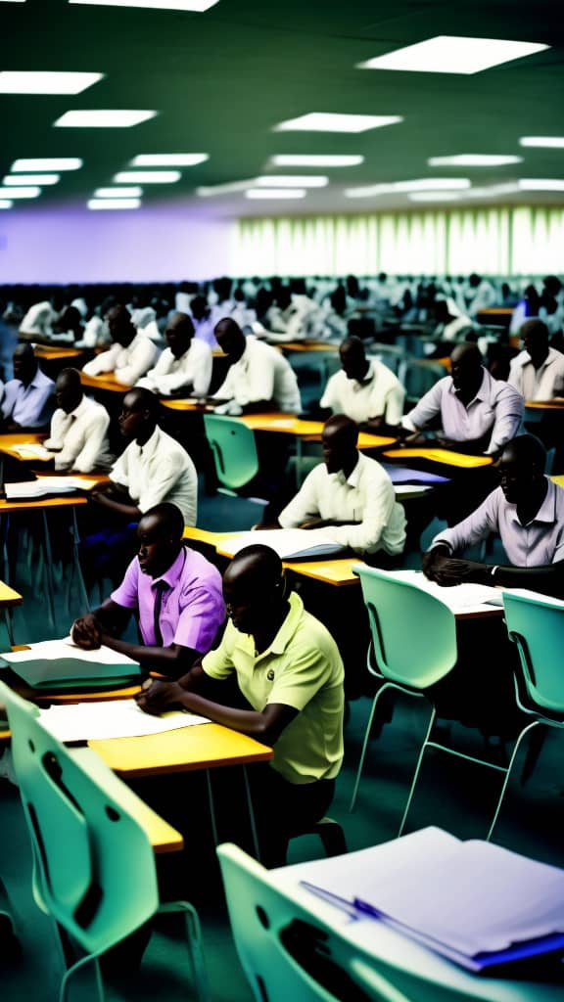
4
INVEST IN HUMAN CAPITAL DEVELOPMENT (EDUCATION, HEALTHCARE AND POVERTY ERADICATION)
Agencies Focus On Human Capital Development To Enhance Productivity
HUMAN CAPITAL DEVELOPMENT
Ministry of Women Affairs and Poverty Alleviation to hold the regular short term women development programme, Y2023 Provision for widow empowerment, as well as Y2023 Mega Empowerment programme (Poverty Alleviation Programme).
The Women Development Centre, Agege to be upgraded/ renovated, and the Skill Centre at Ibeshe town, Amuwo Odofin to be constructed.
Construction of 2 Institute for Care Giver and Securing of Land for Additional Shelter for GBV Women as well as the Construction of Garri Processing, Market stall and Community Hall ,Ibeshe town, Amuwo Odofin LGA to be completed. to be completed
HUMAN CAPITAL DEVELOPMENT
The Art of technology (AOT) Conference to be held to accelerate talent and increase innovative talent in Lagos.
Early - stage Tech companies to be invested in at the Eko Vention (which connects innovators to investors). Young Nigerian Scientist Presidential EXPO & Award to also be held for 774 people.
Startup assistance to be provided for 500 people living with disabilities and Solar farm empowerment for 400 youths.
Gemstone Hub to be created and the ongoing Industrial leather hub project to be completed. Virtual market database portal to be completed. 85% as at Q4 Y2022.

Slide 43

DEPLOY FUNCTIONAL TECHNOLOGY IN PUBLIC SPACES
5
The State is deploying functional technology in public spaces
TECHNOLOGY IMPROVEMENT
The SMART city project is currently underway. 450 surveillance cameras have been deployed in Y2022.
Cybersecurity Project (25% of State IT assets to be protected to secure assets and security platforms in Lagos state).
TECHNOLOGY IMPROVEMENT
IT development and implementation standards to be formalized and standardized, with 50% information technology system harnessed in 2023 (Enterprise Architecture Project).
Masterplan to be designed for KITE Yaba Hub Project for a knowledge-driven smart economy.

Slide 44

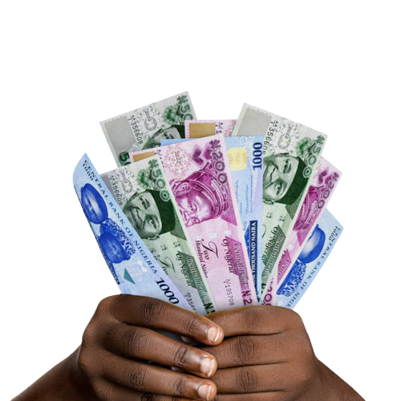
6
IMPROVE CAPACITY TO COLLECT DUE REVENUE AS EFFICIENTLY AS POSSIBLE
6
Revenue Has Achieved A Good Performance Despite The Challenges Of The Global Economic Downturn Due To The Resilient And Efficient Management Of The State Economy
EFFICIENT REVENUE GENERATION
To increase revenue generation, MOT to build 57 Computerized Vehicle Inspection Centres through PPP arrangement, which should be delivered in Y2027; Generate Pin numbers for all applicants as computerized test for drivers license in 24 driving centres in the state, and Install mobile and fixed cameras on operational vehicles and designated areas (Platedetect (ANPR).
MVAA to issue Temporary Vehicle Tags (TVT) to all imported vehicles coming through the port, to enhance security and safety in the state. This should be completed by the end of Q1 Y2023.
EFFICIENT REVENUE GENERATION
LIRS to use data to identify about 1,000 High Net Worth Individuals residing in the state and write to them to file their tax returns; implement law requiring MDAs to request evidence of tax clearance from persons they deal with; as well as establish specialized tax / revenue courts for resolving tax disputes and other related issues including land use charges by the end of Q3 Y2023.
LABCA to continue use of green sticker and site log book; implementation of E-monitoring and Data management; Drone implementation; Citizen self demolition services, as well as issuance of certificate of completion and fitness for habitation to new and existing buildings.

Slide 45

ATTRACT INVESTMENTS THROUGH PUBLIC-PRIVATE PARTNERSHIPS BY CREATING AN ENABLING ENVIRONMENT
7
The State Is Laying A Good Framework To Drive Initiatives To Enable Our Environment Support The Private Sector By Improving The EODB
IMPROVED CAPITAL INVESTMENT & EODB
One stop shop in CBD to be completed.
Development of Imota Light Industrial Park is ongoing.
IMPROVED CAPITAL INVESTMENT & EoDB
Truck light industrial park (Phase 1 & 2) to be constructed at Lekki Free Zone. 24 Youths were trained at the MCIC / Fashion Hub at the Lekki Free Zone settlement in Y2022.
Investment Promotion and Branding, as well as Aftercare services to investors (starter and existing) provided yearly by Office of Sustainable Development Goals and Investment

Slide 46

8
IMPROVE HEALTH CARE SYSTEMS, ENVIRONMENT AND PUBLIC SPACES
The Quality Of The Environment, Public Spaces And Security Continue To Pose A Challenge, Given The Population Size, Habits And Enforcement Capability.
IMPROVED PUBLIC SPACES
Annual Climate Change Summit Carbon footprint & Greenhouse gas emission inventory to be updated.
Climate Action Plan (CAP) Implementation Carbon for 500 participants including experts from Government, Academia, Private Sectors, Civil Society and Students
1,700 No of Public spaces and utilities to be Disinfected / Decontaminated.
IMPROVED PUBLIC SPACES
Development of Lagos State Waste Management Policy.
1110 no.s of Toilet to be constructed in public spaces by Office of Environmental services.
In order to prevent flooding, Office of drainage services to carry out maintenance cleaning of secondary channels and clearing of primary channels in the 20LGAs of the state. Primary channels to be dredged in different locations as well.
LAWMA plans to create Transfer Loading Stations (TLS) in all the LGAs of the State for fast and smooth evacuation of waste around the metropolis.
LASPARK to plant trees, prune trees, trim and blow over trees; propagate plant seedlings maintain gardens, establish recreational and event activities State-wide, as well as rehabilitate and beautify open spaces.

Slide 47

8
IMPROVE HEALTH CARE SYSTEMS, ENVIRONMENT AND PUBLIC SPACES
The Quality Of The Environment, Public Spaces And Security Continue To Pose A Challenge, Given The Population Size, Habits And Enforcement Capability.
IMPROVED HEALTH CARE SYSTEM
LASHMA’s Health Insurance Scheme “Ilera Eko” Programme has enrolled 625,000, with over 250 participating hospitals in Lagos State.
100 health facilities to be empaneled into Ilera Eko providers in Y2023.
To increase enrolment of vulnerable Lagos residents in 57 LGAs/LCDAs, LASHMA flagged off its Y2023 EKO Social Health Alliance (EKOSHA) enrolment of the vulnerable and indigent at Ijede LCDA, Kosofe LCDA, Kosofe LGA, Odi-Olowo LGA, Iru-Victoria Island LCDA, Epe LGA, Egbe-Idimu LCDA, Apapa LGA, Ojodu LCDA, Coker-Aguda LCDA, and Oriade LCDA
Ifako-Ijaiye General Hospital to be renovated; Specialist Hospital to be constructed (Construction on Oncology Centre at Gbagada General Hospital;) 5 Ambulance Bases to be constructed; and 10 additional Mobile Intensive Care Unit (MICU) ambulance vehicles to be procured.
IMPROVED HEALTH CARE SYSTEM
Architectural Design to be prepared for rehabilitation of hospitals and CCTV to be provided in 14 General Hospitals.
Construction of New Massey Street Children Hospital Main Building to commence in July and Perimeter fencing to commence in August.
Ongoing Acquisition/Expansion of Land for Orile-Agege General Hospital; Construction and Equipping of Psychiatry Hospital, Ketu Ejinrin; Rehabilitation and upgrade of GH Lagos with architectural Design as well as Ibeju Lekki General Hospital, 280 bed General Hospital,Ojo and Doctors Quarters LASUTH to be completed
Traditional Medicine Board to be demolished and constructed.

Slide 48

8
IMPROVE HEALTH CARE SYSTEMS, ENVIRONMENT AND PUBLIC SPACES
The Quality Of The Environment, Public Spaces And Security Continue To Pose A Challenge, Given The Population Size, Habits And Enforcement Capability.
IMPROVED HEALTH CARE SYSTEM
500KVA Generators and inverters to be procured and installed for 3 State Health Facilities.
4 Youth friendly centers to be rehabilitated
Construction of New Massey Street Children Hospital Main Building to commence in July and Perimeter fencing to commence in August.
Landed property to be acquired for 3 General hospital expansion.
IMPROVED HEALTH CARE SYSTEM
Ongoing Online training of 400 Nurses for clinical Competences both in training and practice; Training of 45 Midwives on Advanced Life Saving Skills (ALSS) to reduce maternal and infant mortality; 4 Nos of Limb Deformity & cleft lip/Palate corrective programs for Children under 12(Twelve); and Provision of access to mental Health Counseling and Psycho-social support services through Lagos Lifeline (Suicide Hotline) to be completed.
500 students/teachers to be sensitized on dangers inherent in drugs abuse.
1200 patients to be screened for eye health services and 500 glasses to be given.
2000 students to benefits from eye screening both in primary and secondary schools in the state.
8000 people to be screened and vaccinated against viral hepatitis.

Slide 49

9
IMPROVE YOUTH ENGAGEMENT, PARTICIPATION AND EMPOWERMENT
The State Retains A Huge Opportunity To Engage And Empower Our Youths Visibly. Progress Is Being Made As Planned But Not As Impactful As Desired.
YOUTH ENGAGEMENT & EMPOWERMENT
Equipment and grants to be provided for the Y2022 Entrepreneurship skills development programme for 1500 artisans and tradesmen.
Employability skills development and technical training for 500 youths
Start-up assistance for 500 people living with disabilities; and solar farm empowerment for 400 youths to be completed.
YOUTH ENGAGEMENT AND EMPOWERMENT
Renovation of Badagry, Isheri, Oba Sanni Komolafe, Ipaja and Popo-Oba youth centres to be completed.
Youth Education and Enlightenment Campaign Programme, Youth Leadership Programme as well as Youth Vocational Skill and Empowerment Programme to take place.
Sensitization /Advocacy programs for all schools in Lagos state to prevent Delinquency and Ensure School Attendance and Development Programme on parenting for Adoption of orphan /Vulnerable Children.
Special correctional Centre for boys oregun (Phase 1 & 2) as well as vocational rehabilitation Centre for person living with Disability Owutu/Ikorodu to be renovated.

Slide 50
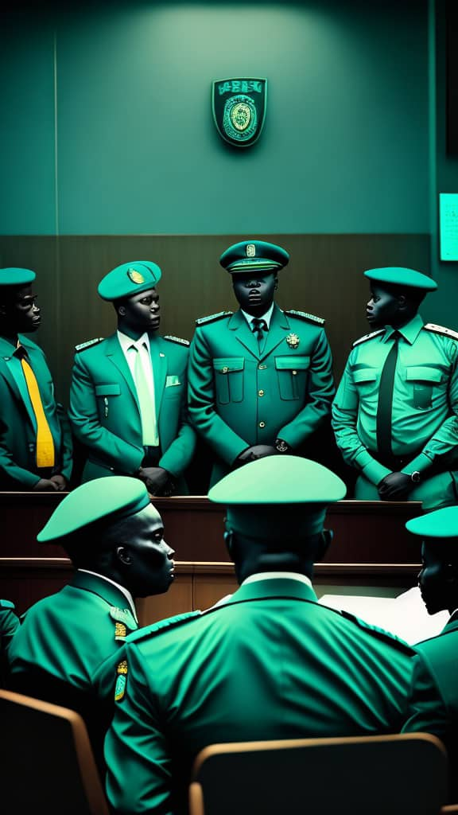
10
REBUILDING LAGOS
Restoration/Upgrade and Securing Of Damaged Public Assets
IMPROVED JUSTICE & SECURITY
Ongoing Renovation of Magistrate courts at Ogba & Ikeja; Ebute-Metta; Tinubu, Lagos Island; Badagry, and Wharf, Apapa to be completed.
Ongoing Court recording processing technology and visual equipment project to be completed.
Ongoing Correctional centre to be renovated & Construction of High & Magistrate courts at Igando and Imota to be completed.
Ongoing Construction of Police area command at Idimu (Phase II & III) and Elemoro, Ibeju Lekki (Phase II & III), as well as the Construction of CMC office at Ijede to be completed.
IMPROVED JUSTICE AND SECURITY
Appeal Court Judges residences at Glover road, Ikoyi and Queens drive, Ikoyi to be renovated
High/Magistrate court to be digitalized.
Ongoing Construction of Upgrade of Lekki Police Post to Police Station as well as Renovation of LASTMA / Police Officers Buildings (A & B) at State House, Alausa – Ikeja by Office of the chief of Staff to be completed. 25% & 50% work had been done respectively in Y2022.
Office of the Chief of Staff to construct SSS Office at Ikeja LGA; Elepe Police Station, Igbogbo-Baiyeku LCDA, as well as General Rehabilitation of Mopol 49 Squadron, Akodo in Y2023.
12bn has been earmarked by LASEMA for Provision of Rescue and Emergency operation equipment for Disaster Managers.

Slide 51
Q1 Y2023
OBSERVATIONS AND RECOMMENDATIONS

Slide 52
Observations and Recommendations – 1/3
REVENUES
The Total Revenue performed at 76% as at end of Q1 Y2023 with LIRS performance at 87% while IGR (others) performed at 36%
With increasing investment towards infrastructural development, the State Government must begin to look towards creating business opportunities around proposed, ongoing, and established infrastructures. The Government must be a first-tier beneficiary of the economic value created by the infrastructures built, in terms of making informed decisions, enforcing regulations and standard of business conducted, generating tax from value added, coordinated infrastructure maintenance, and improved standard of living of its people as opposed to touting and hawking that has characterized most of the city centers and infrastructure sites
There is a need to identify State-Owned asset value through third-party claims, then financialize these assets by issuing asset-backed securities
The State must focus on improving its currently low tax penetration. Lagos State should impose a “State Excise Tax”, particularly on harmful goods like alcohol and tobacco. These taxes can also be imposed on betting and gambling winnings- an industry worth over $2 billion per annum and rising
Establish a Strategic Management Unit to monitor and provide support in delivering all MDA mandates in the Lagos State civil service
CAPEX: INFRASTRUCTURE AND SYSTEMS UPGRADE
Total Capital Expenditure closed at 75% with Core Capital Expenditure at 79% and Repayment at 94%.
Capital expenditure performance as at Q1 looks promising, and is a reflection of government enormous spending to reduce infrastructure deficits particularly in the areas of transportation, health, and creating a business friendly environment
While raising taxes on one hand to improve revenue generation, Government must increase spending on projects with the highest rate of social return to stimulate the economy. This will help to balance out the effects of raising taxes which often leads to slow economic growth

Slide 53
Observations and Recommendations – 2/3
Rising global interest rates significantly increases the cost of borrowing and existing loan repayments to both businesses and government
It is recommended that DMO takes up a more reflective role to advice Government on long term debt risks and cost, control cash flow, effective use of cash reserves, debt consolidation, and securitization and financialization in debt servicing
DEBT SUSTAINABILITY
PERFORMANCE MANAGEMENT
Transformation of reform programs through Public Financial Management (PFM), Policy & Strategy implications, and Monitoring and Evaluation to improve the fundamental drivers of economic growth
Establish a strategic management office domiciled with the Economic Intelligence Department of the State to use the outcomes of the performance management reports to advice on MDAs project priorities and budget envelopes in subsequent years
CITIZENS PARTICIPATION AND ENGAGEMENT
Continuous engagement with People and Business entities through various fora on a wider scope is necessary to harvest broad based feedback from Citizens

Slide 54
Observations and Recommendations – 3/3
EMPLOYMENT
With rising cost of living triggered by supply shocks in food and energy, severe unemployment challenges are imminent. Lower-income households, which must devote a significantly larger share of their incomes to necessities, are being hit especially hard by the inflationary squeeze caused by the supply shock
Government must identify and invest in current and future skills gap to improve youth employability levels.
Support should be channelled to identified sectors that can create decent and productive employment
HUMAN CAPITAL DEVELOPMENT
The State needs to consolidate efforts of its Eko Innovation Centre and Lagos State Employment Trust Fund (LSETF) to support the emergence of Data Scientists, Data Analysts, Software Developers, and other most sought after skills, who can work remotely from Nigeria, serving Africa and the world in the next 5 years. This would boost revenue generation from income taxes as well as position the State as Africa’s Pemium Technology Hub
Citizen’s wellbeing enhancement programmes should be improved upon to promote active involvement of the teeming youth in socio-economic areas of choice.
LASHMA needs to continue their effort on awareness campaigns to capture more citizens into the Health Schemes
HUMAN CAPITAL DEVELOPMENT
To improve the state's ranking on EoDB, Lagos should pay close attention to its Commerce and Industry regulations and policies in order to create a systemic intervention that addresses all factors affecting EoDB.

Slide 55
CONCLUSION
The Q1 Y2023 Revenue recorded a performance of 76% (N269,609bn)
Q1 Y2023 Recurrent Expenditure recorded a performance of 61%(N113,227bn)
Q1 Y2023 Capex recorded a performance of 75% (N191,686bn).
Q1 Y2023 Budget performed at 69% (N304.913bn).

Slide 56
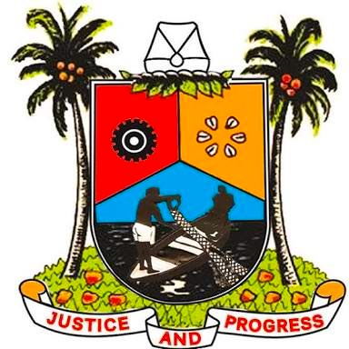
Ministry of Economic Planning and Budget
Government Secretariat, Alausa, Ikeja,
Lagos State, Nigeria.
web: http://mepb.lagosstate.gov.ng
email: info@lagosstate.gov.ng
twitter: @followlasg

